Slide 1
Chaotic mixing of charged PARTICLES IN lower regions of the ionosphere
BY: CHRISTOPHER LUNA
2014 Statewide Arizona/NASA Space Grant Undergraduate Research Internship Program Symposium

Slide 2
Chaotic Mixing in the Ionosphere
Project Overview
  Background
  Mathematical Model
Initial Simulations
Improved Simulations
Future Directions

Slide 3
Chaotic Mixing in the Ionosphere
Project Overview
  Background
  Mathematical Model
Initial Simulations
Improved Simulations
Future Directions

Slide 4
Background
The dynamics of the Earth’s ionosphere are of great interest because of their importance in space physics and telecommunications.
Numerical simulations are a valuable tool for investigating the dynamics of the ionosphere at lower altitudes (E-F regions) because they are too low for orbiters and too high for weather balloons to take direct measurements.

Slide 5
Model Outline
We use observationally based parameters to describe the plasma in the ionosphere, and perturb the neutral atmospheric flow around mean dynamics.
We consider the bottom 100km of the mid-latitude ionosphere E and lower F region. In these regions, temperatures vary between 300K-1200K, and the number density for plasma varies roughly between 10²-10⁴cm⁻³.
We solve the coupled Lagrangian dynamics of the charged and neutral particles, and calculate the ion density and electric potential throughout to the plasma to satisfy density transport and charge conservation assuming quasi-neutrality and a constant magnetic field.

Slide 6
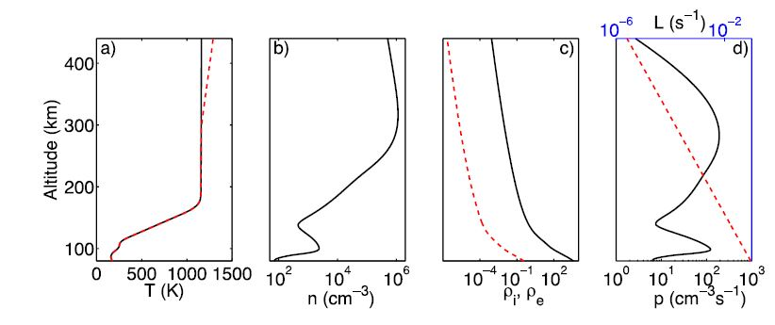
Charged Particles ICs
Initial profiles in dimensional units. (a) Plasma temperature. Black solid curve: ion temperature. Red dashed curve: electron temperature. (b) Ion density. (c) Normalized collision frequency. Black solid curve: ion. Red dashed curve: electron. (d) Reaction parameters. Black solid curve: production rate, coordinate at bottom of figure. Red dashed curve: recombination rate, coordinate at top of figure. Vertical axes are the same in all panels.

Slide 7
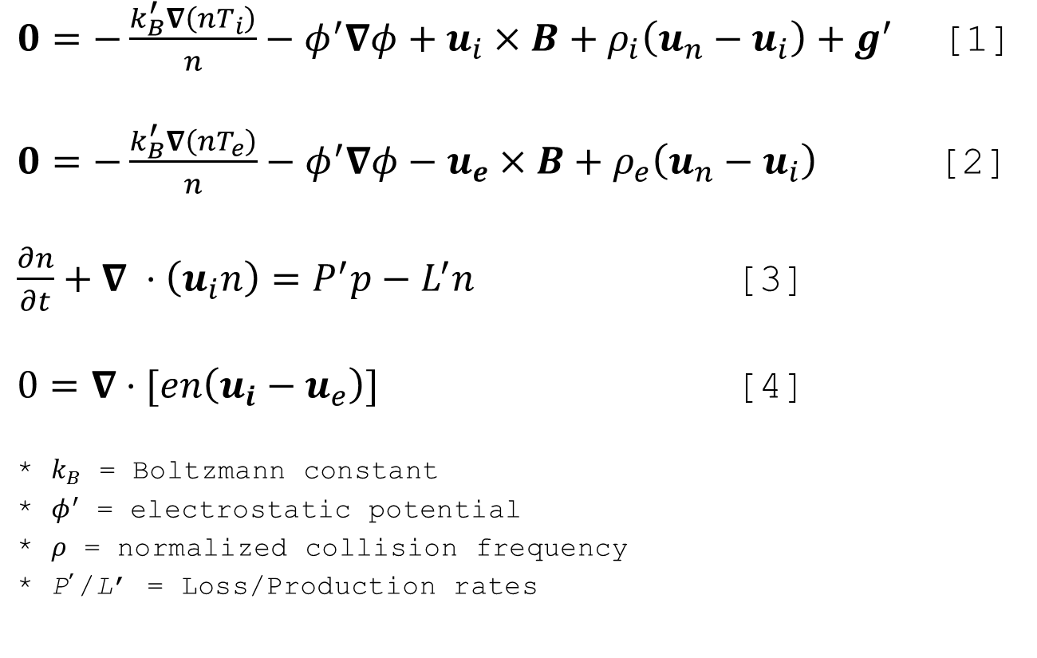
Charged Particle Dynamics
$0=−\frac{k_{B}^{′}∇\left(nT_{i}\right)}{n}−φ^{′}∇φ+u_{i}×B+ρ_{i}\left(u_{n}−u_{i}\right)+g^{′}$ [1]
$0=−\frac{k_{B}^{′}∇\left(nT_{e}\right)}{n}−φ^{′}∇φ−u_{e}×B+ρ_{e}\left(u_{n}−u_{i}\right)$ [2]
$\frac{∂n}{∂t}+∇ ⋅\left(u_{i}n\right)=P^{′}p−L^{′}n$ [3]
$0=∇⋅[en\left(u_{i}−u_{e}\right)]$ [4]
* $k_{B}$ = Boltzmann constant
* $φ^{′}$ = electrostatic potential
* $ρ$ = normalized collision frequency
* P’/L’ = Loss/Production rates

Slide 8

Neutral Particle Dynamics
$\frac{{∂u}_{n}^{}}{∂t}+u_{n}⋅∇u_{n}=−∇p+\frac{1}{Re}∇^{2}u_{n}+f$ [5]
$∇⋅u_{n}=0$ [6]
* $Re≡V_{0}L/v$
* $v$ is the effective eddy viscosity
* $f$ is the driving mechanism

Slide 9
Chaotic Mixing in the Ionosphere
Project Overview
  Background
  Mathematical Model
Initial Simulations
Improved Simulations
Future Directions

Slide 10
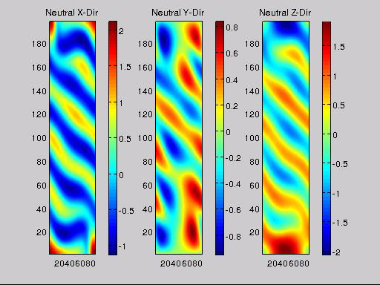
Neutral - Unperturbed Dynamics

Slide 11
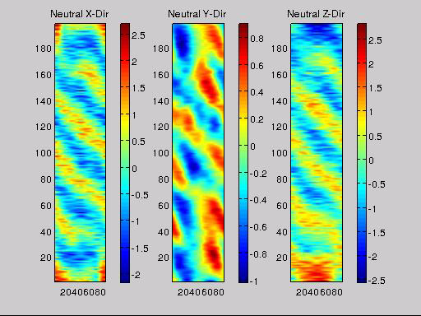
Neutral - Perturbed Dynamics
Negative Amplitude, Negative Phase
Positive Amplitude, Negative Phase
Negative Amplitude, Positive Phase
Positive Amplitude, Positive Phase

Slide 12
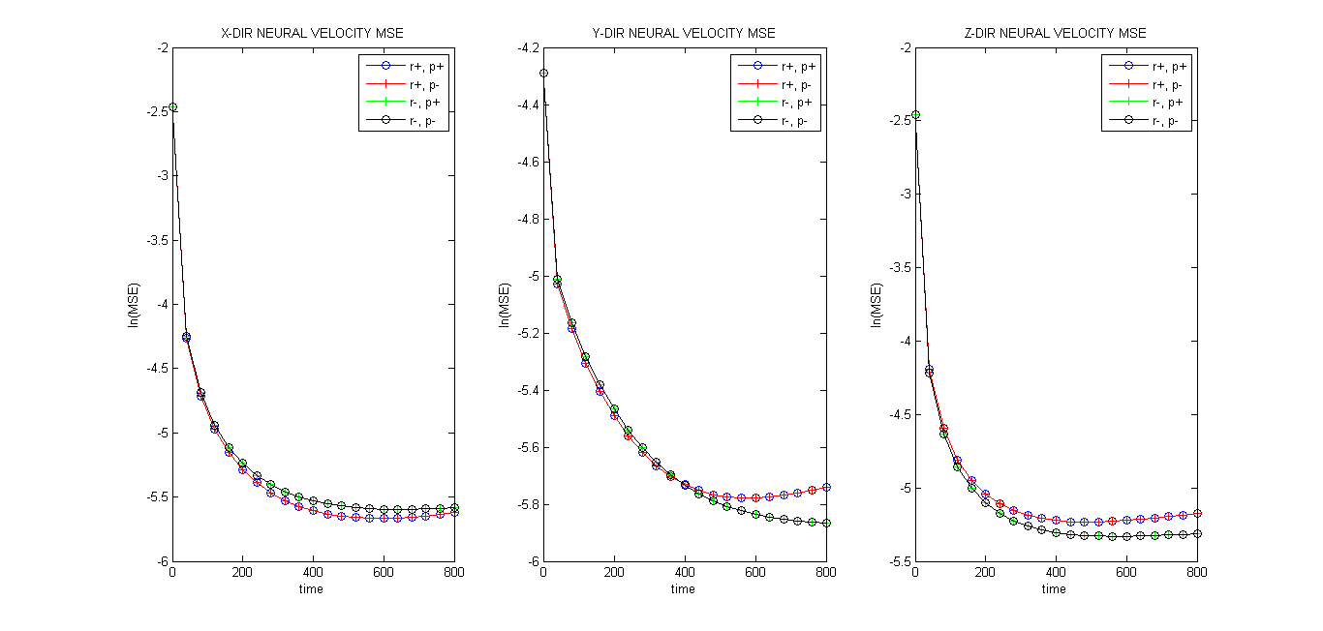
MSEs for Neutral Velocities

Slide 13
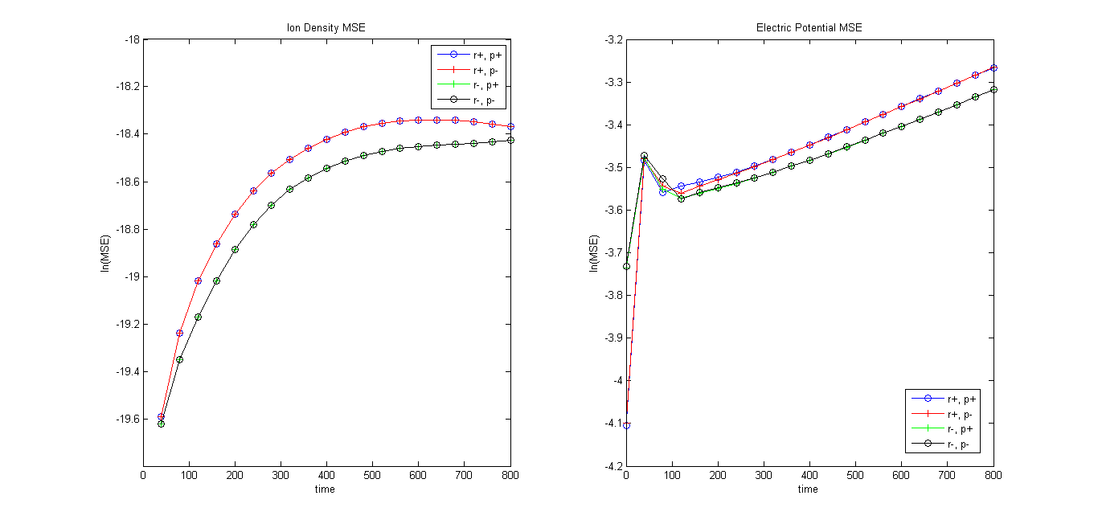
MSEs for Ion Den./E.P.

Slide 14
Chaotic Mixing in the Ionosphere
Project Overview
  Background
  Mathematical Model
Initial Simulations
Improved Simulations
Future Directions

Slide 15
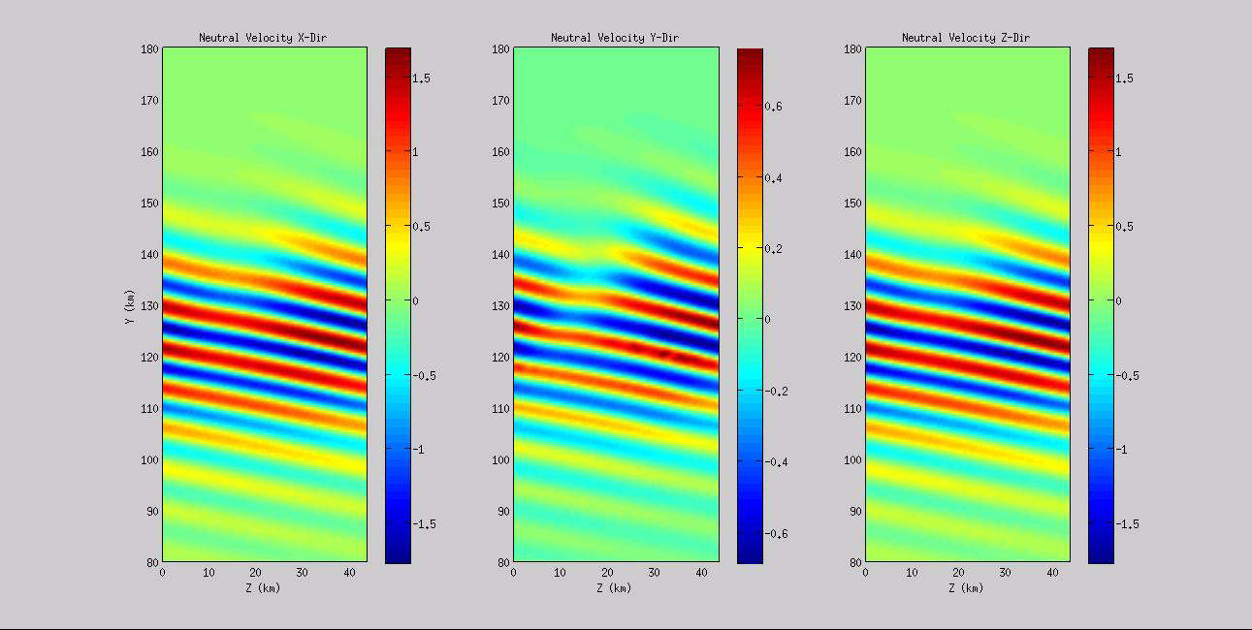
Neutral - Unperturbed Dynamics

Slide 16
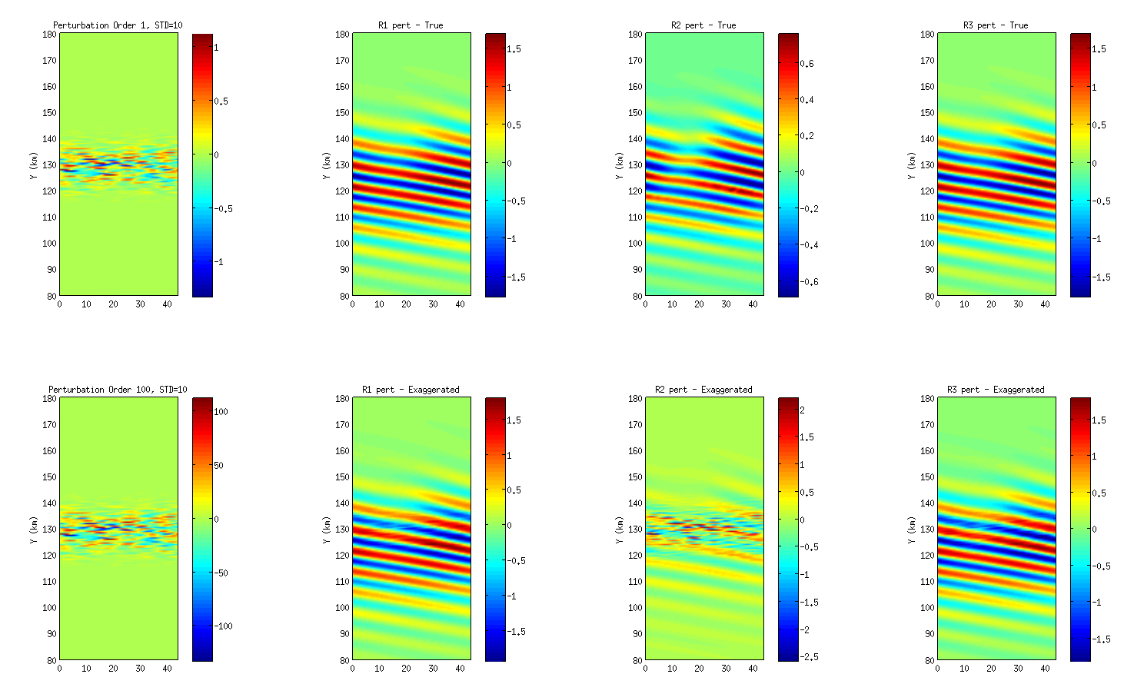
New Perturbation Profile

Slide 17
Neutral - Perturbed Dynamics

Slide 18
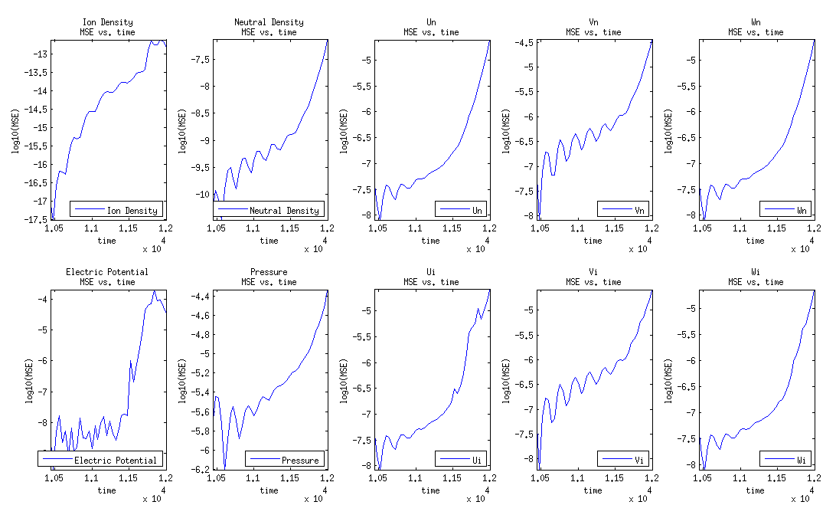
MSEs - New Perturbation

Slide 19
Chaotic Mixing in the Ionosphere
Project Overview
  Background
  Mathematical Model
Initial Simulations
Improved Simulations
Future Directions

Slide 20
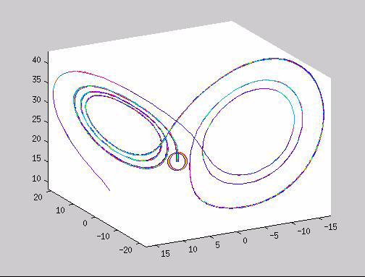
Future Directions
Sample a larger range of perturbations to further investigate the stability of neutral dynamics and the range of their variability.
Determine the
most unstable
eigenvalues and
eigenfunctions
of the system.

Slide 21
Acknowledgements
NASA Space Grant
Wenbo Tang - Mentor
Evan Scannapieco – Co-mentor

Slide 22
Thank you!
Questions?

